Slide 1


SRMCEM LUCKNOW
PRESENTATION – ON
Cloud Computing
PRESENTATION: PRESENTED TO:
1. AMARJEET Mr.MAHENDRA(IBM)
2. SUDHANSHU CHAUDHARY
3. PANKAJ KUMAR
4. SACHIN PATEL
5. JAYPAL CHAUDHARY

Slide 2
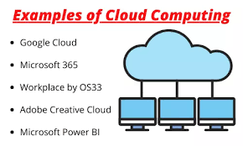
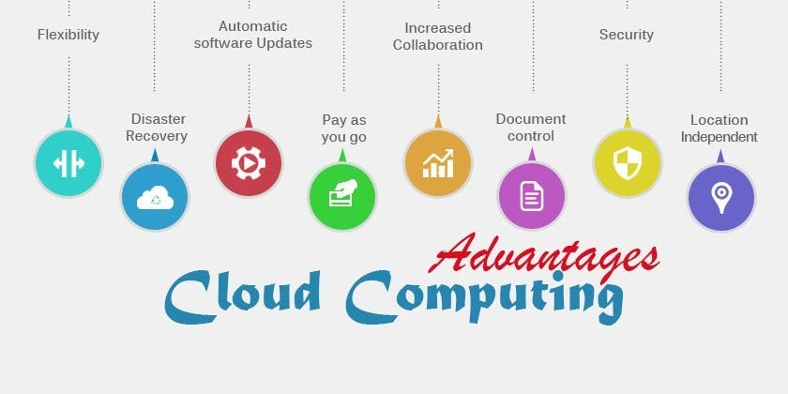
Introduction
Cloud Computing is the delivery of computing services such as servers, storage, databases, networking, software, analytics, intelligence, and more, over the Cloud (Internet).

Slide 3
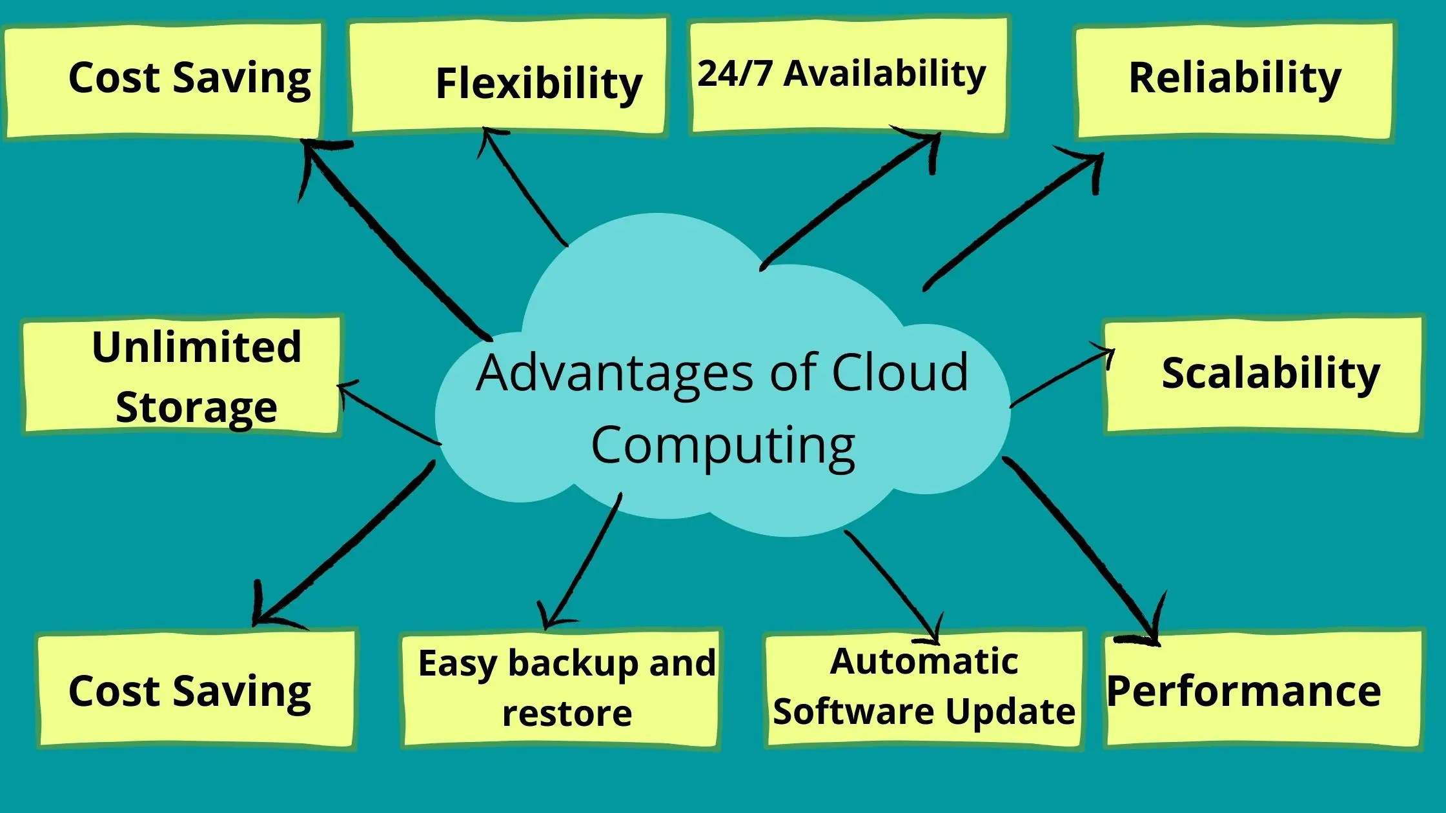
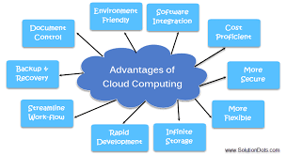

Slide 4
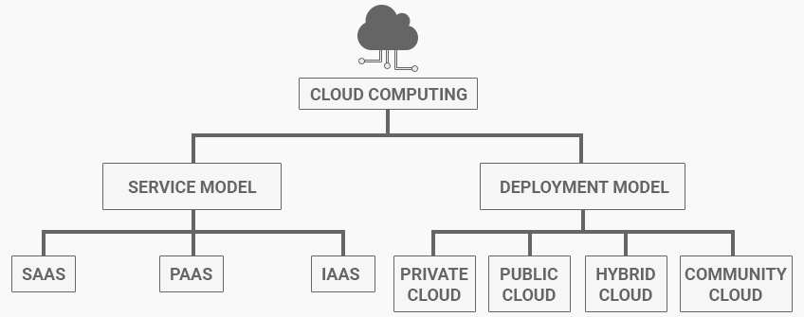
Real Time BenefitsCloud Computing:
1.Data backup
2.Email
3.Disaster recovery
4.Virtual desktops
5.Big data analytics
6.Software development
7Testing

Slide 5
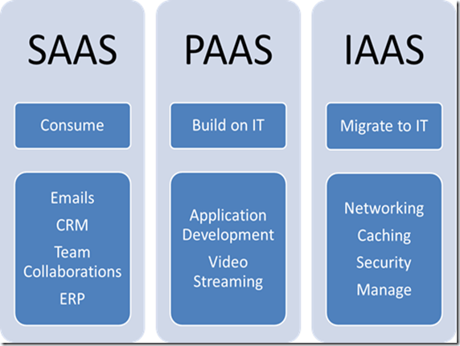
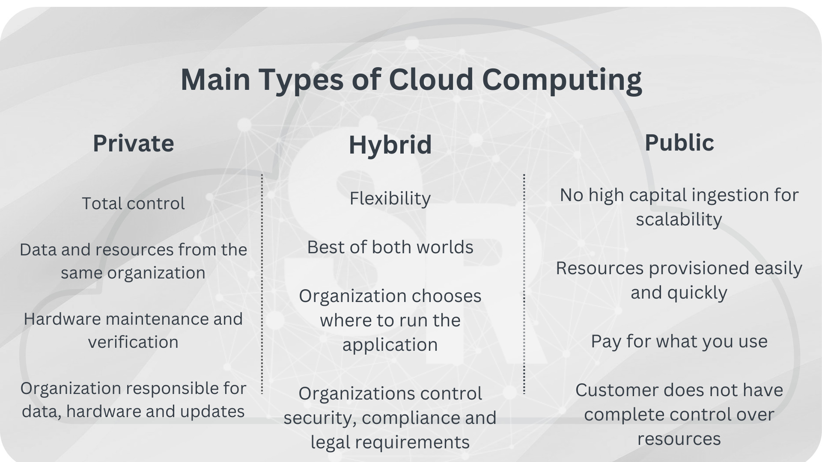
There are also three main types of cloud computing Services:-Infrastructure-as-a-Service (IaaS), Platforms-as-a-Service (PaaS), and Software-as-a-Service (SaaS).
Public cloud — data and other info delivered over the internet that can be shared with various people and organizations.
Private cloud — data and other info that is only accessible to users within your organization.
Hybrid cloud — a combination of the two. This environment uses public and private clouds.

Slide 6
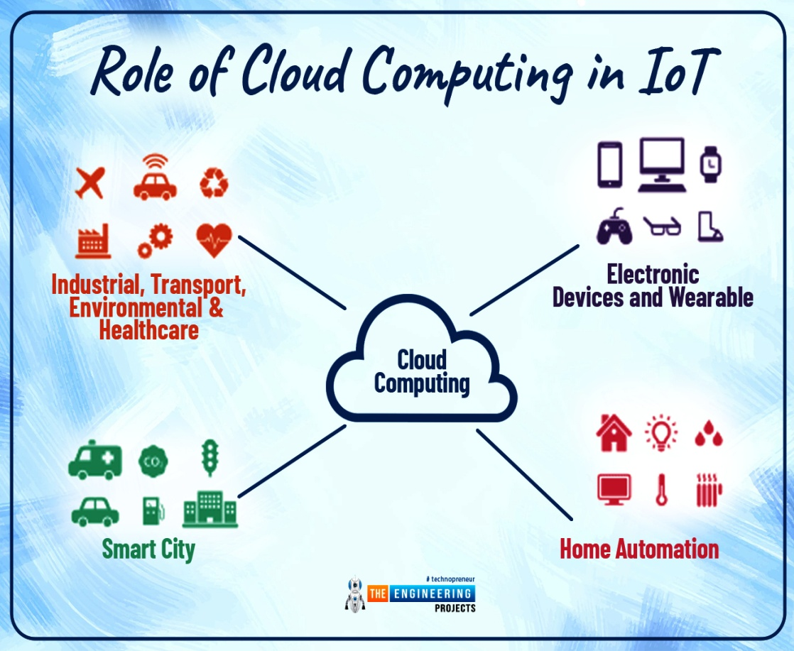
Cloud Computing Support IoT:-
One component that improves the success of the Internet of Things is Cloud Computing.Cloud computing enables users to perform computing tasks using services provided over the Internet. The use of the Internet of Things in conjunctio with cloud technologies has become a kind of catalyst: the Internet of Things and cloud computing are now related to each other. These are true technologies of the future that will bring many benefits.
Blockchain in Cloud Computing:- Blockchain is a decentralized, distributed database that allows secure information sharing among different parties. It consists of a growing list of records, called blocks, linked together using cryptography. Each block contains a cryptographic hash of the previous block, a timestamp, and transaction data.

Slide 7
Calclusion
Cloud Computing is the fastest growing part of IT
Tremendous benefits to custmers of all sizes.
Cloud services are simpler to acquire and scale up or down

Slide 8
THANKU ALL SRMCEM IBM TRAINER

